Slide 1

Target Stores Sales Analysis Target is American mass –marketing retail company operating large-scale food and general-merchandise discount stores.

Slide 2
Objectives of My Analysis
1. Yearly Sales
2. Sales By Categories
3. Products Sold per order
4. Sales Map
5. Profit by Ship Mode
6. Butterfly chart for the sales of 2018 and 2019 specifically

Slide 3
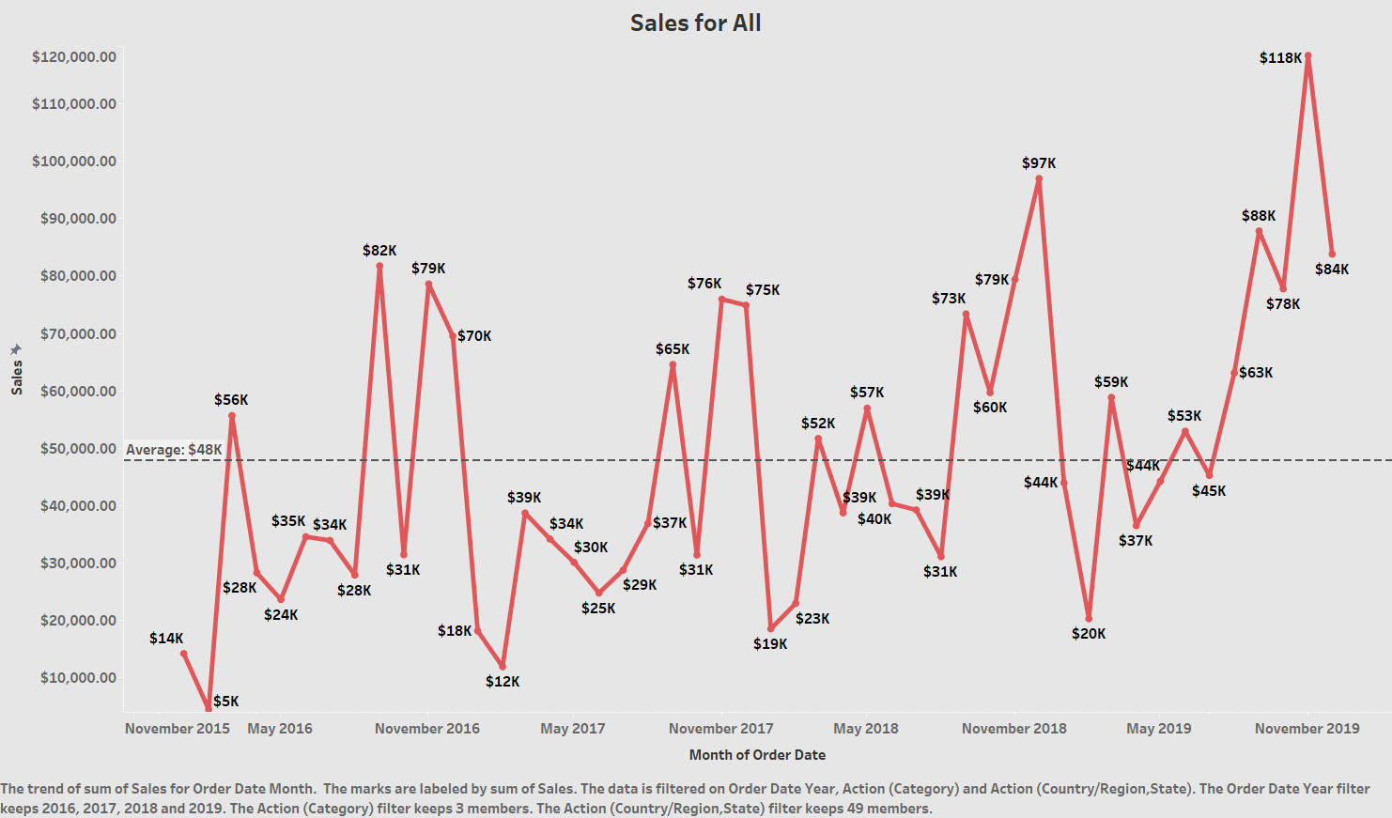

Slide 4
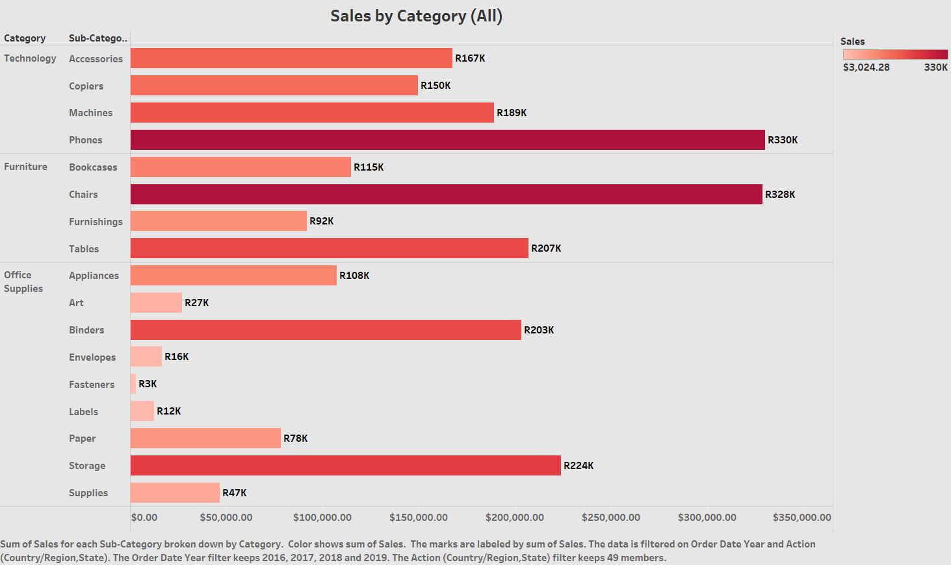

Slide 5
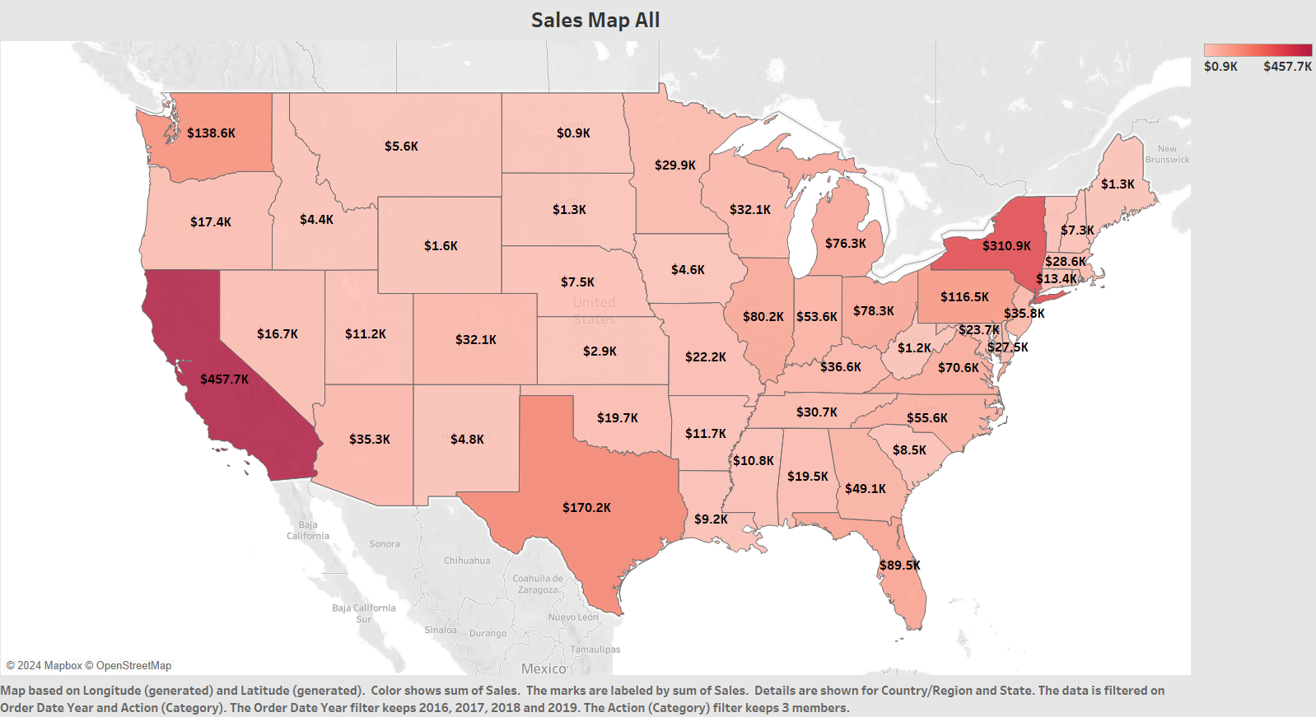

Slide 6
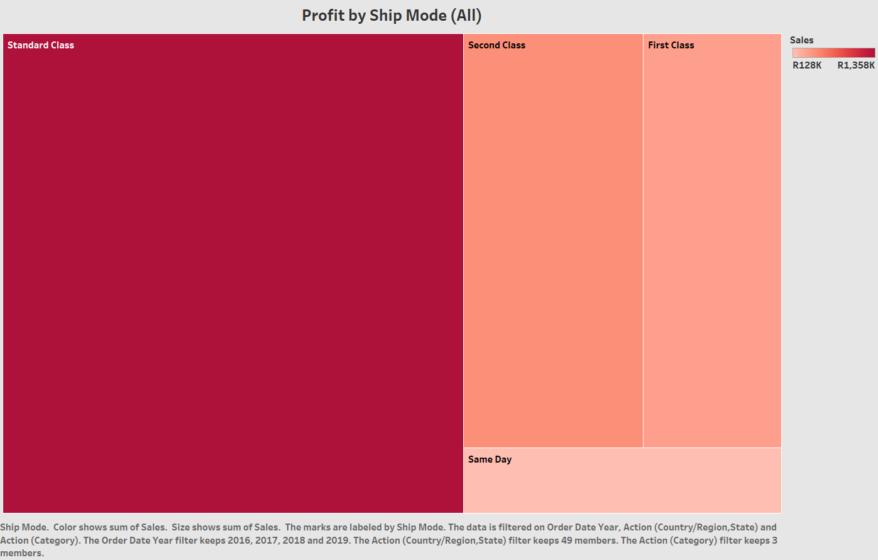

Slide 7
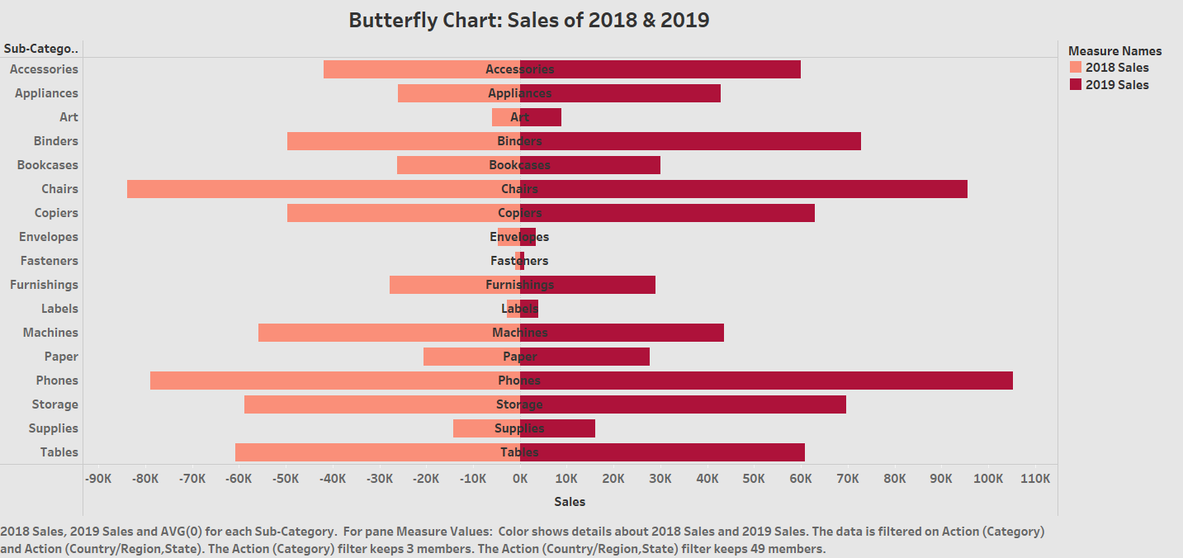

Slide 8
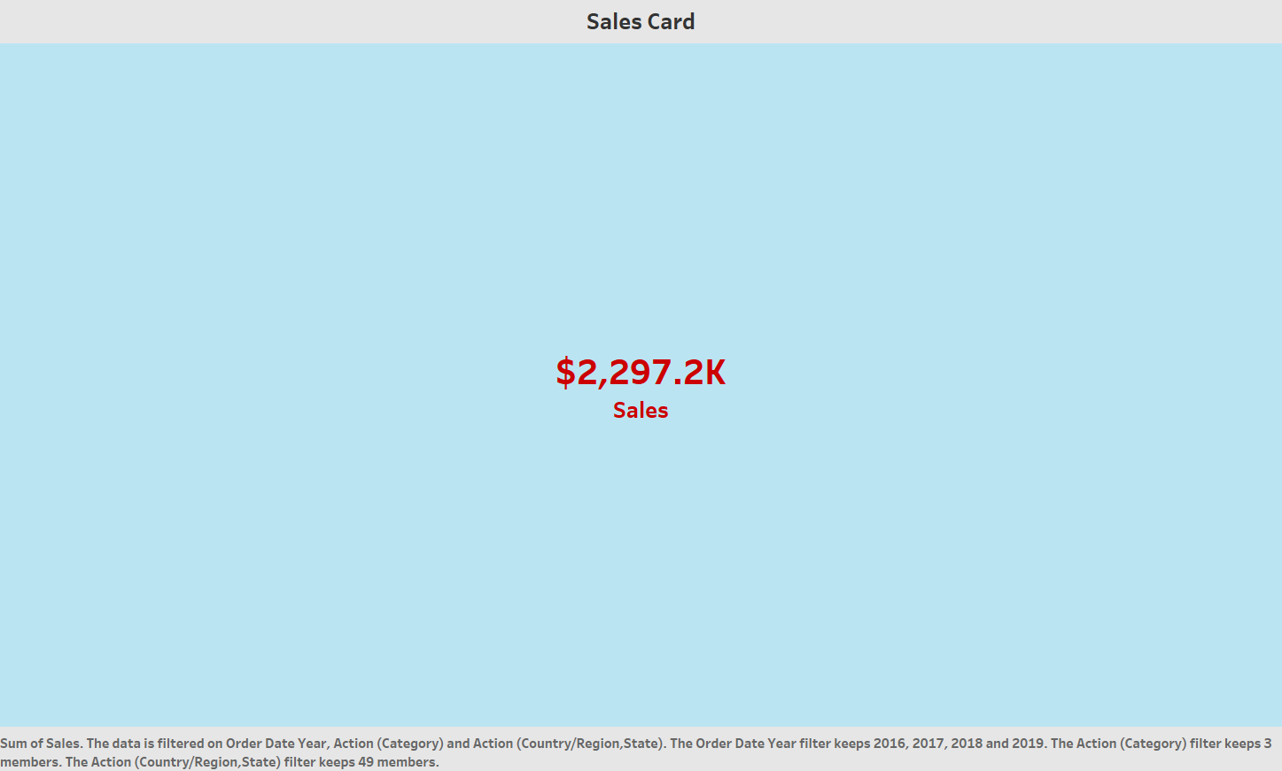

Slide 9
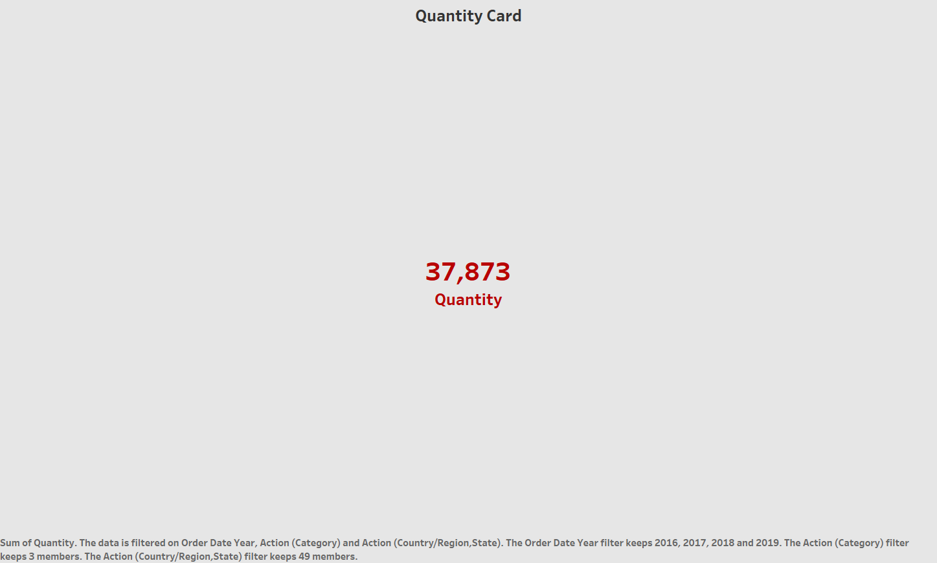

Slide 10
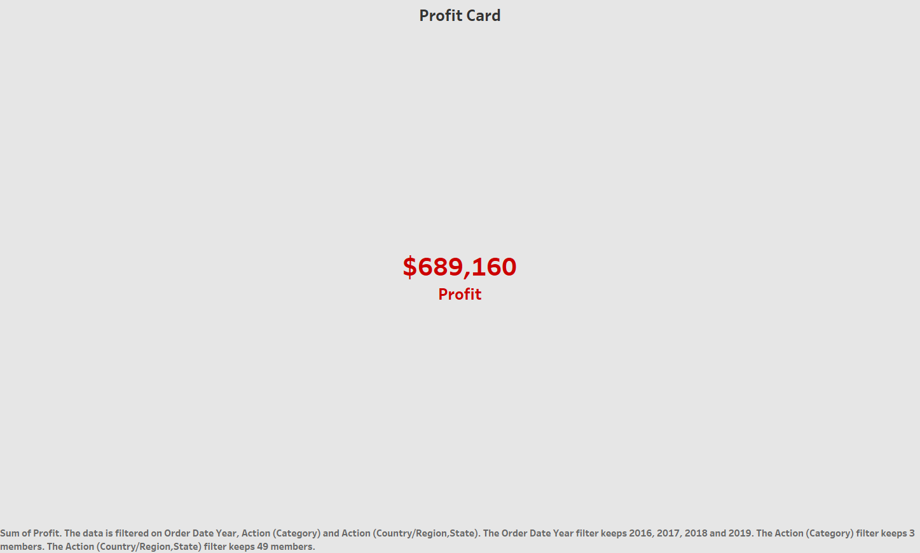

Slide 11
*CONCLUSIONS
Visualize the Sales of TARGET over:
the years 2016, 2017, 2018 and 2019
Which states are using target more than others
Butterfly chart to compare sales by category of 2018 and 2019 side-by-side
Overall by we can assess the categories and states which are hotspots for these stores and get and overall idea about the condition of TARGET STORES
THANKYOU

